Slide 1

P peline
The Data
Final Exam Review
© Jennifer Mankoff
The Data Pipeline; HCII; Spring 2015

Slide 2
Final Project
Discussion of handin expectations: Website, presentation http://data.cmubi.org/assignments/final-project
Discussion of presentation expectations:
15 minutes to present, 5 minutes for questions
5 groups per day
Sample presentations slides

Slide 3
Tuesday Presenters
Singapore [don’t have title]
Measuring Immigration
ISIS twitter network analysis
Visualizing Digital Friendships
Health$care [missing title]

Slide 4
Thursday Presenters
Which State Has the Best Pizza?
Pantheon, the dataset by MIT Media labs about historical figures from Wikipedia
Analyzing factors that influence diabetes patients readmission
Discover and plan social events in your city!
Ask Us Anything for Reddit AMA

Slide 5
Final Project
Slide Template posted on piazza for use in your preparation
Needed all groups to email me title and preferred presentation day by this morning
Presentation attendance is required
Projects are due 9am Tuesday
Any Questions?

Slide 6
Final Exam
Reverse final exam
You write 5 questions AND answers
Each question should cover a different aspect of the class as considered in the lectures and readings.
Questions should assume open book/notes/etc. but taken in a limited time of ½ hour per “long answer” question (less for “short answer”)
You nominate ‘best questions’; I take an exam based on those nominations ☺

Slide 7
What makes a good question?
It is clear
It stays on topic (doesn’t bring material from outside the class in)
It is not ambiguous (multiple interpretations or correct answers)
It is not obscure
More than ¼ of the class could answer it in the time allotted
It requires some thought to answer

Slide 8
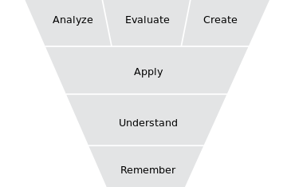
Bloom’s Taxonomy
Notes:
Helps to describe what makes questions difficult!

Slide 9
Question Types
Long Answer
between 1500 and 3000 characters long (including your answer)
Short Answer
Four alternative answers
Include explanation for each one of them

Slide 10
Final Exam Grading
You grade 5 x 5 questions (10 long answer, 15 short answer)
Your grade is based on
How well you grade your peers (15%)
How well your peers grade you (85%)
Any adjustments we the staff decide are needed if there are issues with the peer grading.

Slide 11
Grading Criteria
This is a good question (1)
The question is clear and unambiguous (3)
Right level of difficulty (not too obscure, etc.) (3)
The answer is correct (3)
Word count is between 1500 and 3000 characters (2)
Notes:
----- Meeting Notes (4/23/15 10:06) -----
double check grading criteria

Slide 12
Grading criteria for your peer grading
Good written feedback on ALL questions (meaningful comments/suggestions)
Clearly explain reasons for sub-scores below 3

Slide 13
Final Exam Timeline
Exam opens Monday May 4
Must submit questions by Friday May 8
Must peer grade by Sunday 5/10

Slide 14
What I consider to be key material from the class
Will review that now to help focus you and answer any questions

Slide 15
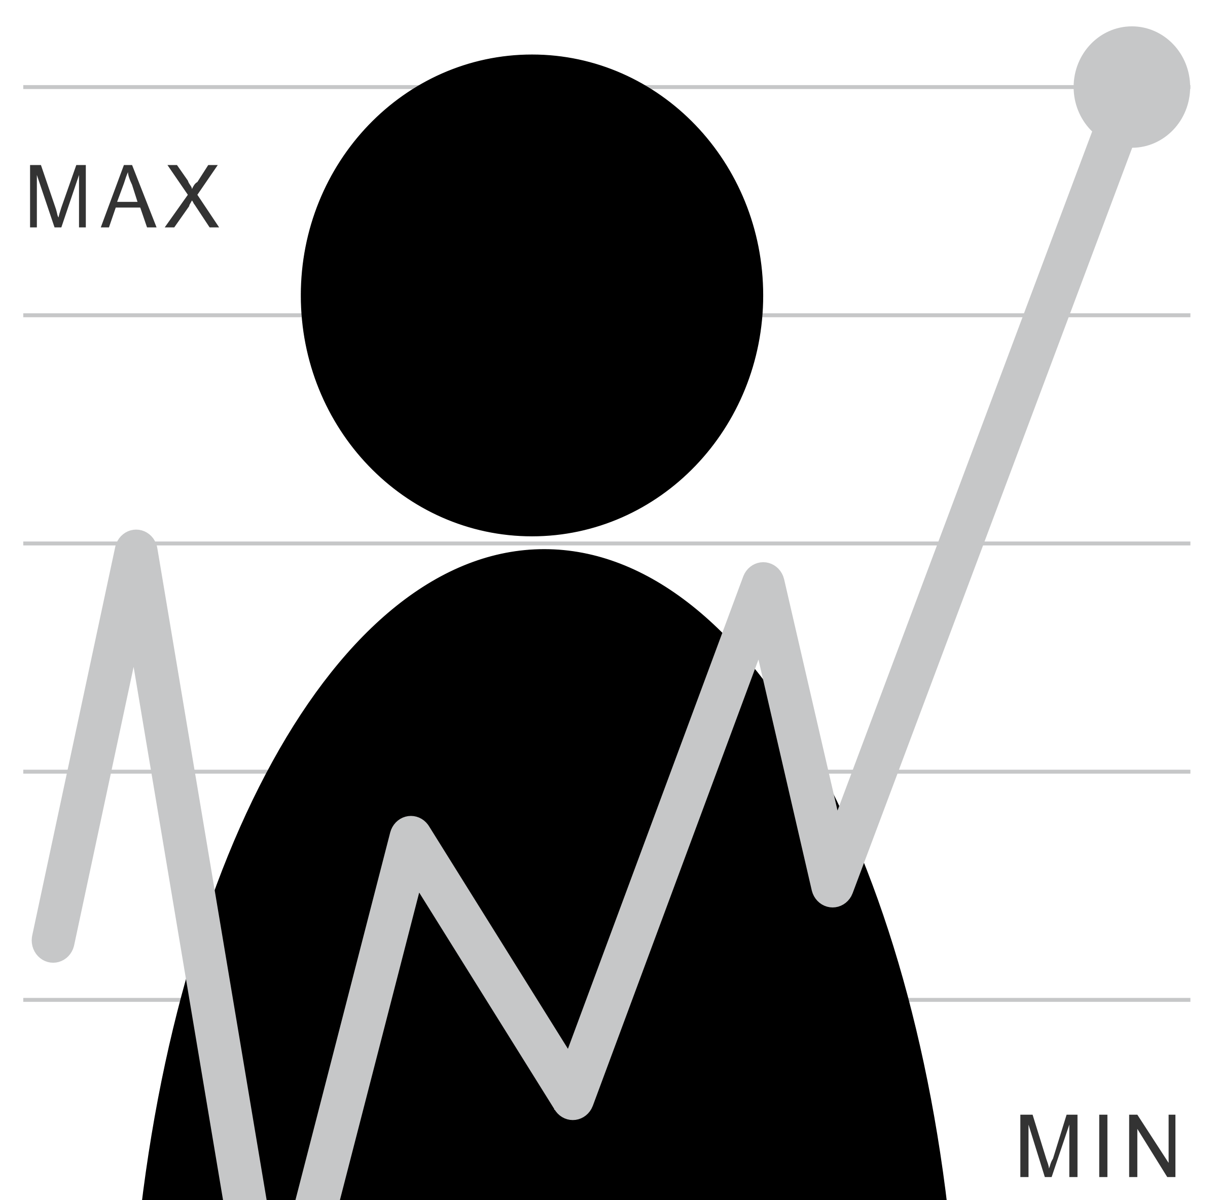
The Data Pipeline
Question
Is it the right question?
Collect Data
Is it the right data for the question?
How hard/easy is it to collect?
Clean Data
What flaws exist in the data?
How do we address them?
Is it answerable?
Explore Data
Intuition
Use data
Communicate/Predict/…
Stats/Graphs/ML
Report on Findings
Visualize

Slide 16
What Type of Data Exist?
Constant (e.g., mouse gain)
Continuous Data: Ration/Interval (e.g., mouse location)
Discrete Data (often scales): Nominal/Ordinal
(e.g., slip/no slip on this interaction)
What are the units?
Notes:
Interval: Scales that describe values where the interval between the values has meaning. Temperature.
Ratio: Interval + clear definition of 0. Weight…

Slide 17
What Role?
Descriptor / Feature: predictive of labels (e.g. Click Duration)
Response / Label:
outcome of prediction
response to an intervention / question
(e.g. Diagnosis)
Notes:
Example scripts to address each of these?

Slide 18
Two ways to store data
Data spread over multiple structures that reference each other [Database]
All data in a single structure [JSON; XML; API calls (even over a database)]
Data may include multiple types such as strings and numbers [Both]
Notes:
Many said single structure for database
I would say that’s not true in a typical production database today

Slide 19
Data Storage
Data Management is a people problem
Who should oversee it?
Requires lots of attention, over time, regular checks, etc.
Who is responsible for the four Cs? (Completeness, Coherence, Correctness, AcCountability)
Types of data
Unstructured/semistructured/structured

Slide 20
What is a Data Model?
What data is stored and how it is organized
Key benefits:
Leverage (big impact on programming; cost; etc.)
Conciseness (implies an interaction model)
Can encode integrity constraints
Know what makes a good data model (concise, stable & flexible, quick, elegant…)
Notes:
For programs:

Slide 21
Dealing with very large data
Typically distributed [may lead to partitions; maximize consistency or availability: CAP]
Types of data bases to consider
Key-value stores [fast collection, slower query]; e.g. Redis
Distributed, fast schemas [append only, good for exploratino]; e.g. Dremel, BigQuery
Need to consider data processing too
Map-reduce framework for parallelizing operations: batch work
Distributed queries & insertions (e.g. Hive)
Distributed ML (e.g. MAHOOT)

Slide 22
Data Acquisition
Lots of existing data
Data streams are a valuable source of data
Need to address security issues
OAuth (2.0) is the current standard
Gives the user / data source control over whether you have access & for how long
Once you get permission you use a key to access the data

Slide 23
Acquiring Data
Data sampling issues
Understand terms: Population, Sample, Random Sampling Error, Bias
Understand what makes a good sample
Understand types of Bias
Systematic Bias, Selection Bias, Non-response Bias
Understand how changing population size affects different types of error [larger sample decreases random sampling error; dosen’t affect Bias]

Slide 24
Dealing with streaming data
Can’t know or store entire stream
Sampling strategy depends on question asked
Account for duplicates; weight samples
Good for online learning

Slide 25
Exploring your data
Transformations such as normalization, logs, and feature creation
Allows different fields to be compared
Avoids undue influence of a column that happens to have large values
Often moves data to 0-1 range
Non-linear transformations (e.g., transforming log-normal data to a normal scale by taking the log)
Notes:
----- Meeting Notes (4/23/15 09:54) -----
don't address feature creation here.

Slide 26
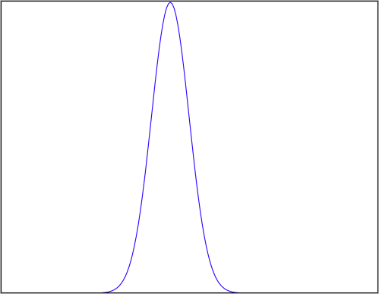
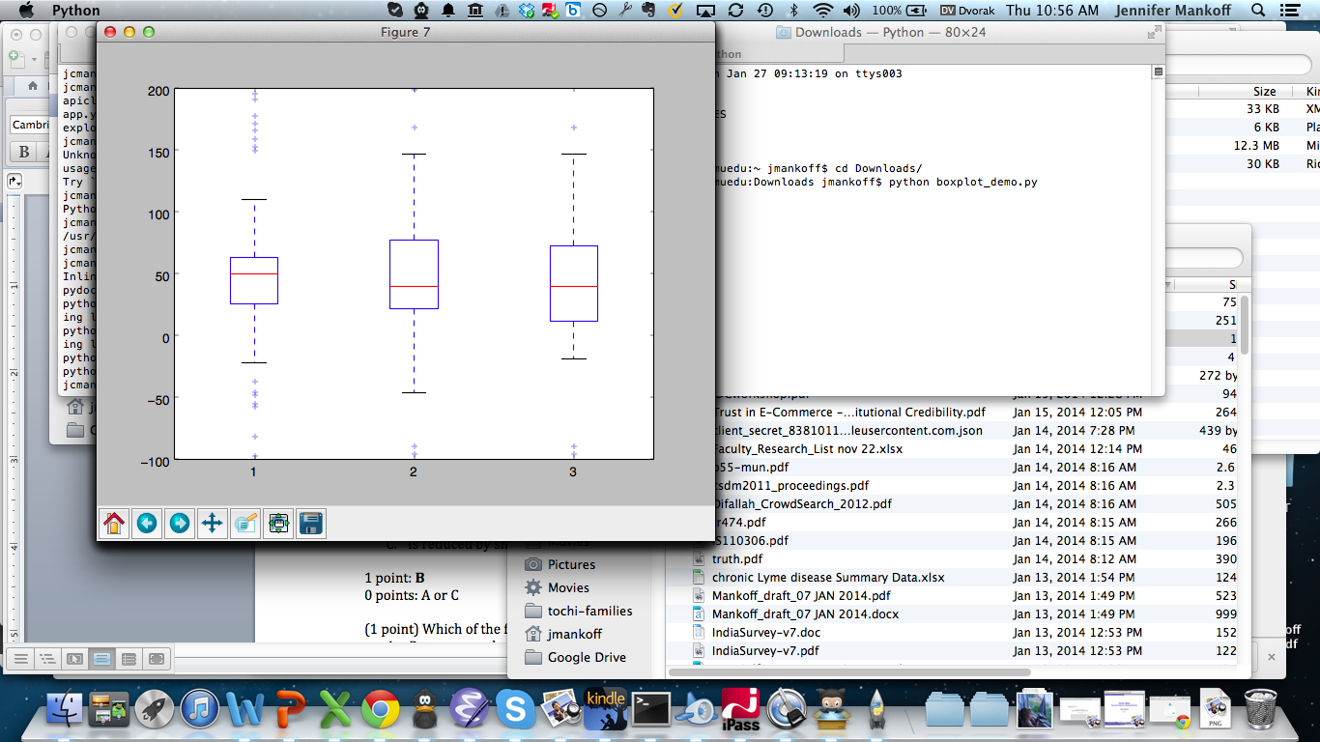
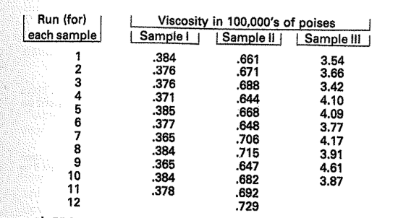
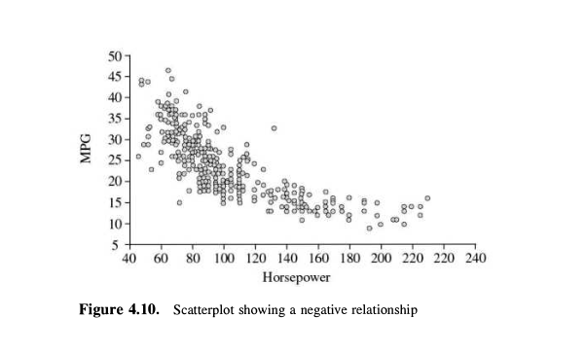
Exploring your data
Transformations such as normalization, logs, and feature creation
Plots and their value
Stem and leaf [flexible & quick]
Boxplot [comparison; some structure]
Histogram [check a distribution]
Scatterplot [show a relationship]

Slide 27
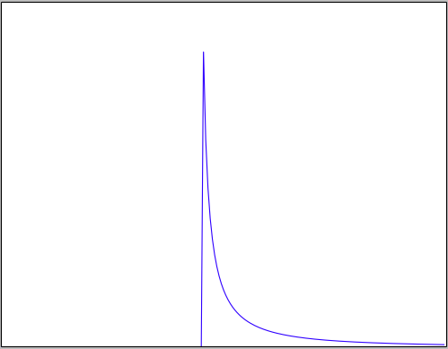
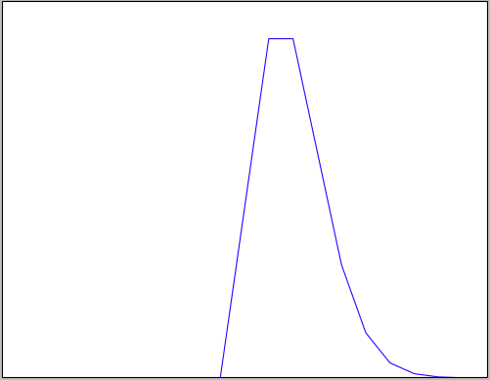
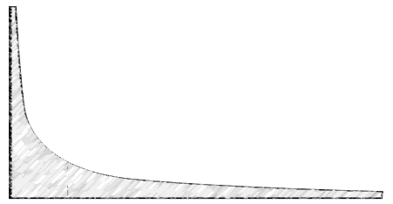
Exploring your data
Transformations such as normalization, logs, and feature creation
Plots and their value – stem & leaf; boxplot; histogram
Distributions and some of their assumptions
Normal: Independent, Identically distributed random variables
Log Normal: Multiplied independent random vars (intuitively: one end is fixed, e.g. timings all > 0)
Poission: Constant rate of independent events
Power Law: Events are not independent; Proportional to 1/k^{n}
Notes:
First reason to explore the data is to check its validity!

Slide 28
Four C’s of Data Quality
Is your data Complete?
Match the question/None missing/None wrong
Is your data Coherent?
Makes sense relative to itself (frequency, values, distribution, outliers, skew …)
Is your data Correct?
Makes sense relative to the world
Not fraudulent/erroneous/badly designed or administered survey/sensor
Is your data aCcountable?
Provenance and documentation
Notes:
First reason to

Slide 29
A process for data cleaning [Coherence & Correctness]
Define & Identify
Detect & Quantify
Detection Algorithms
Quantify Prevalence
Types of Glitches
Importance of Glitches
Clean & Rectify
Develop Strategies
Measure & Verify
Repair
Measure Improvements
Tolerance, cost & bias criteria

Slide 30
Some specific techniques to keep in mind
How to detect and quantify errors?
Glitch signature
Summary statistics
Graphs and Charts
Specific things to look for
Outlier detection techniques
Skew
Techniques for fixing
Imputation
Winsorization
De-Duplication
Domain specific approaches
Notes:
Winsorization: limit outliers (extreme values) to e.g. 90%

Slide 31
Visualizing your data: Guidelines
Set a Goal: Explore/calculate/communicate
Define visual queries/comparisons to support/stories to tell
Document process & provenance for credibility
Create highly interactive and visually integrated systems (images/words/…)
Embed the visualization within a larger application
Provide alternative views

Slide 32
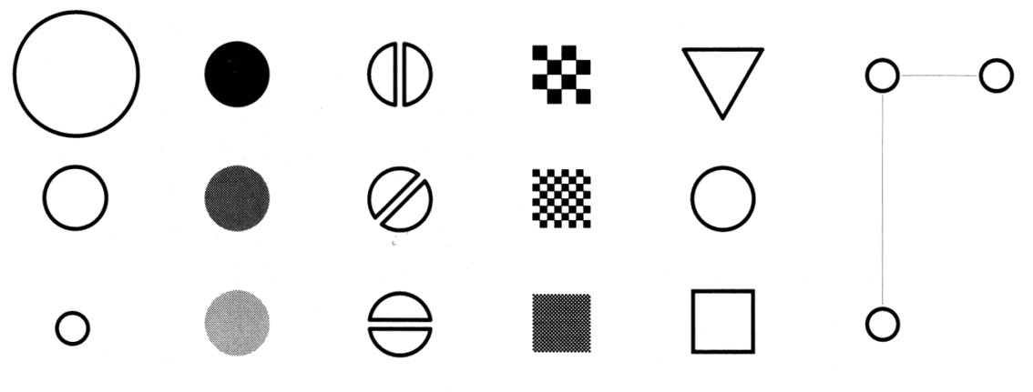
Making Things Distinct
Size
Value
Orientation
Texture
Shape
Position (2D / 3D)
Bertin’s ‘retinal variables’ form the basis for all forms of visual coding. A visual code can be based on (from left to right) contrasts of different types. Hue (chromatic color) provides an addition dimension not shown here.
Kevin Mullet and Darrell Sano, Designing Visual Interfaces
Slide from Marti Hearst/Jeff Heer via Jason Hong
Notes:
Note that while size and other cues provide for quantitative comparison, color (even luminance) only provides for ordering.
If the goal is contrast along any of these axes, make it distinct!

Slide 33
A summary of design elements
Use the eye for pattern recognition: people are good at
Scanning
Recognizing
Remembering images
What they do depends on their “visual query”
Tends to be “just in time”
Key graphical elements
Length
Shape
Orientation
Texture
Animation shows changes across time
Color helps make distinctions
Aesthetics make the process appealing

Slide 34
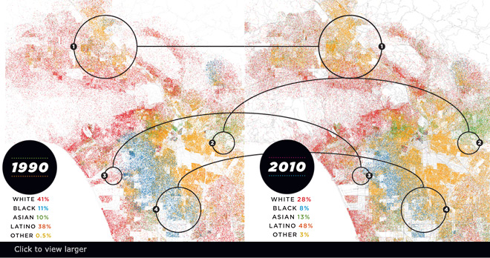
Visualizing Big Data
Make use of every pixel
Notes:
----- Meeting Notes (3/26/15 09:10) -----
storytelling

Slide 35
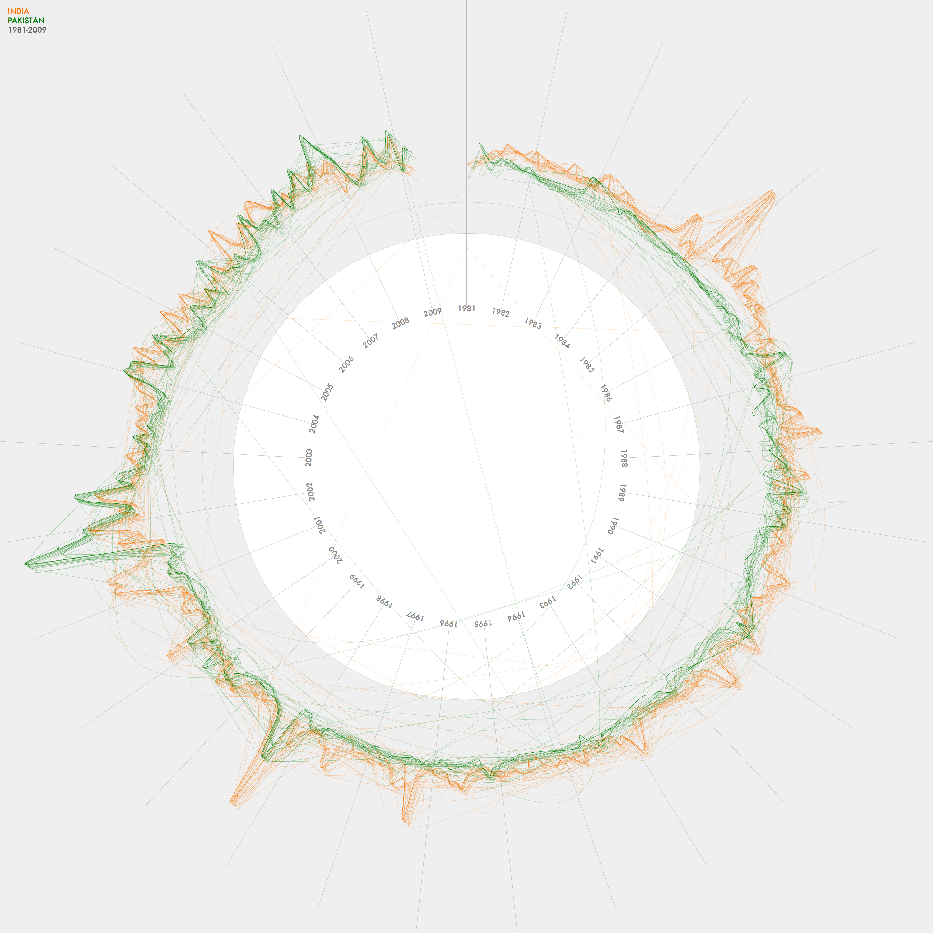
Visualizing Big Data
Make use of every pixel
Use color and location to break the data up and allow the viewer to easily filter

Slide 36
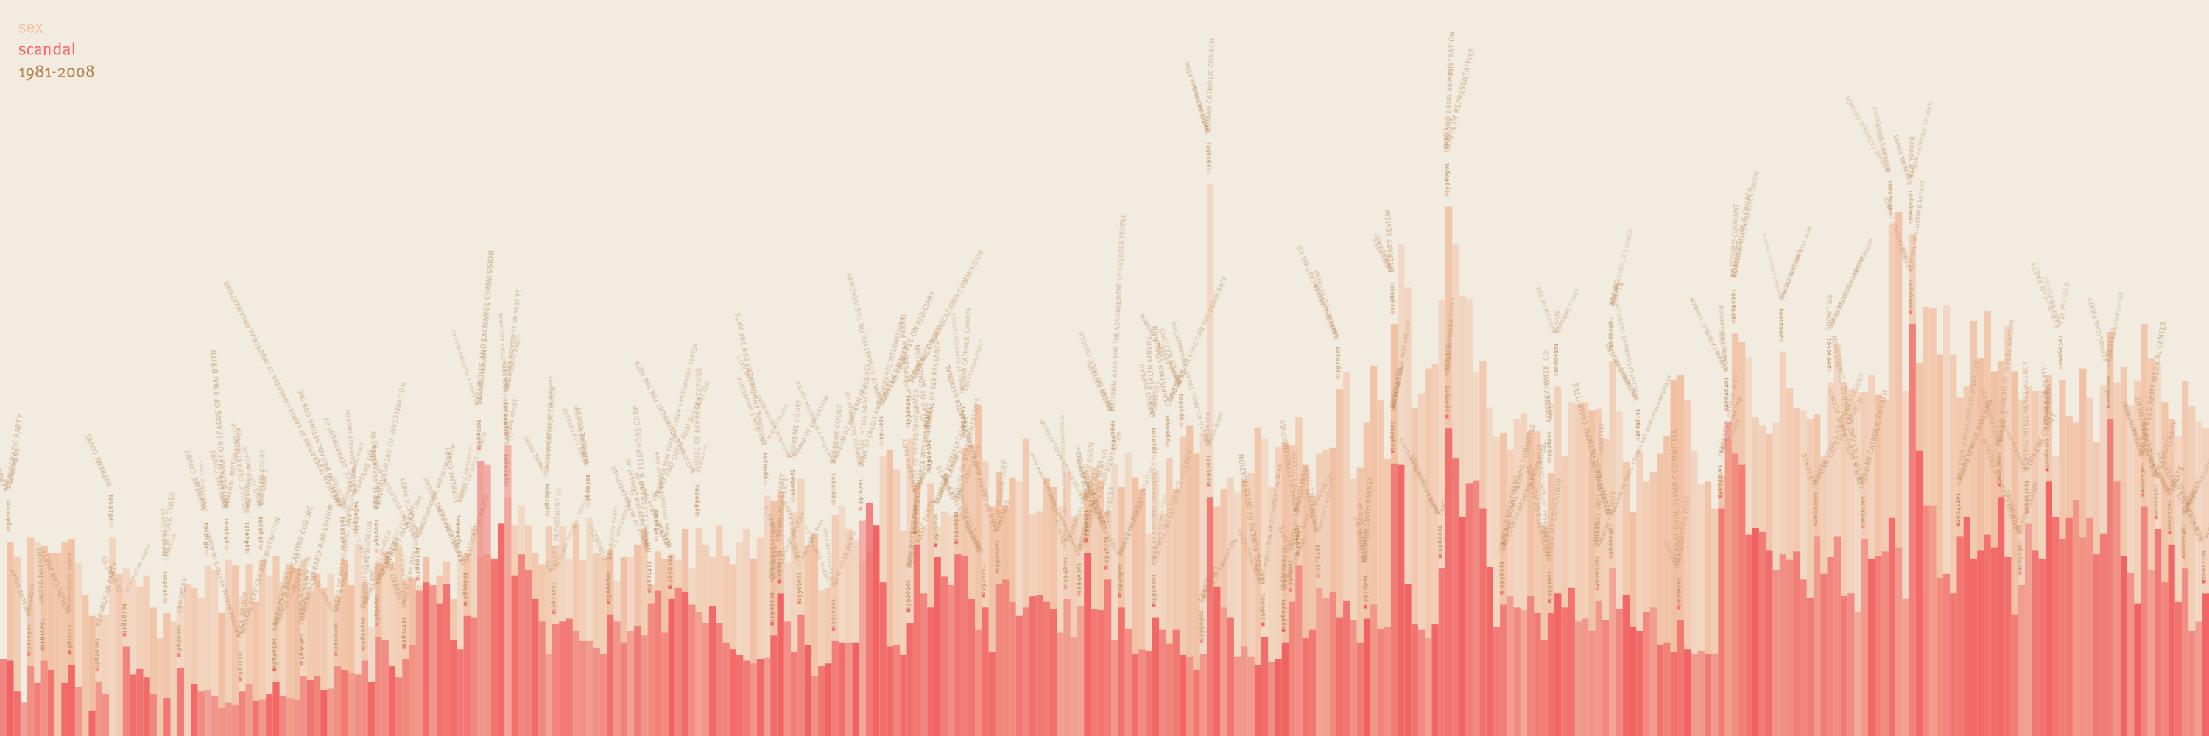
Visualizing Big Data
Make use of every pixel
Use color and location to break the data up and allow the viewer to easily filter
Give a sense of things and use zooming for detail

Slide 37
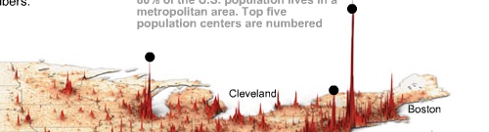
Visualizing Big Data
Make use of every pixel
Use color and location to break the data up and allow the viewer to easily filter
Give a sense of things and use zooming for detail
Add a dimension such as time or height for a key variable

Slide 38
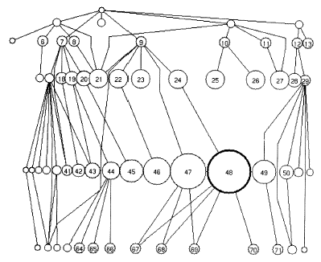
Visualizing Big Data
Make use of every pixel
Use color and location to break the data up and allow the viewer to easily filter
Give a sense of things and use zooming for detail
Add a dimension such as time or height for a key variable
Allow exploration through distortion, filtering, highlighting, and linking

Slide 39
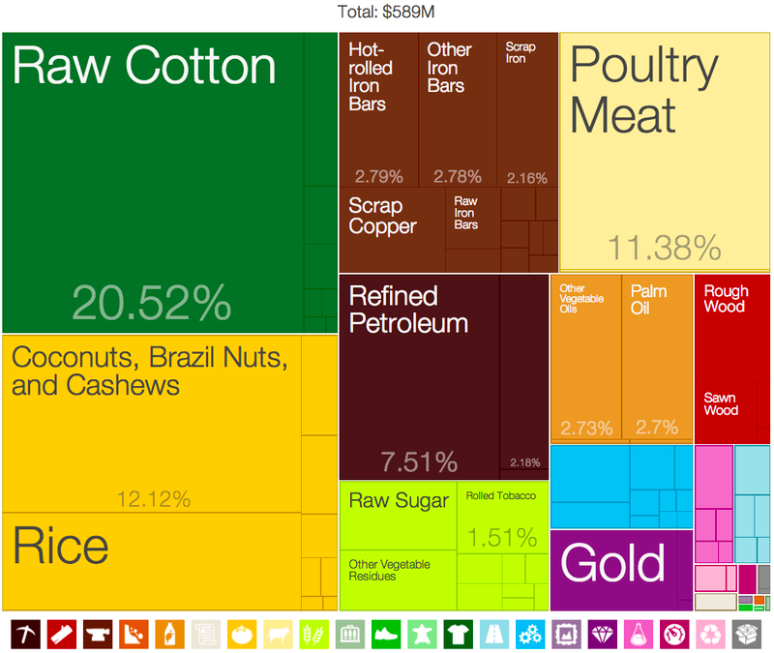
Visualizing Big Data
Make use of every pixel
Use color and location to break the data up and allow the viewer to easily filter
Give a sense of things and use zooming for detail
Add a dimension such as time or height for a key variable
Allow exploration through distortion, filtering, highlighting, and linking
Exploit hierarchy and connectivity

Slide 40
Analyzing your data
Potential for Logical Error
Potential for Systematic Error
Formulate
hypotheses
(Collect) & Analyze data to test hypotheses
Potential for
Random Error
Potential for Errors of Interpretation
Accept hypothesis
Reject hypothesis
Notes:
Start with process data and analysis, only then explore frequency data and analysis

Slide 41
Common Statistical Tests
Outcome Variable | Are the observations independent or correlated? |  | Alternatives if the normality assumption is violated (and small sample size):
 | independent | correlated
Continuous (e.g. pain scale, cognitive function) | T-test: compares means between two independent groups ANOVA: compares means between more than two independent groups Pearson’s correlation coefficient (linear correlation): shows linear correlation between two continuous variables Linear regression: multivariate regression technique used when the outcome is continuous; gives slopes | Paired t-test: compares means between two related groups (e.g., the same subjects before and after) Repeated-measures ANOVA: compares changes over time in the means of two or more groups (repeated measurements) Mixed models/GEE modeling: multivariate regression techniques to compare changes over time between two or more groups; gives rate of change over time | Non-parametric statistics Wilcoxon sign-rank test: non-parametric alternative to the paired ttest Wilcoxon sum-rank test (=Mann-Whitney U test): non-parametric alternative to the ttest Kruskal-Wallis test: non-parametric alternative to ANOVA Spearman rank correlation coefficient: non-parametric alternative to Pearson’s correlation coefficient
Adapted from: www.stanford.edu/~kcobb/hrp259/lecture13.ppt
Notes:
T-test compares the means of two independent groups
R² measures the strength of the association between two variables

Slide 42
Binary or categorical outcomes (proportions)
Outcome Variable | Are the observations correlated? |  | Alternative to the chi-square test if sparse cells:
 | independent | correlated
Binary or categorical (e.g. fracture, yes/no) | Chi-square test: compares proportions between two or more groups Relative risks: odds ratios or risk ratios Logistic regression: multivariate technique used when outcome is binary; gives multivariate-adjusted odds ratios | McNemar’s chi-square test: compares binary outcome between correlated groups (e.g., before and after) Conditional logistic regression: multivariate regression technique for a binary outcome when groups are correlated (e.g., matched data) GEE modeling: multivariate regression technique for a binary outcome when groups are correlated (e.g., repeated measures) | Fisher’s exact test: compares proportions between independent groups when there are sparse data (some cells <5). McNemar’s exact test: compares proportions between correlated groups when there are sparse data (some cells <5).
Adapted from: www.stanford.edu/~kcobb/hrp259/lecture13.ppt

Slide 43
Most statistical tests
depend on the central limit theorem and thus its assumptions
The sample is normal
If multiple samples, they are independent & have the same variance
Can make two kinds of errors (Type I & II)
Common Pitfalls
Low rate of replication of findings [Ionnadis]
Bias (‘findings’ may actually be measuring bias) [Ionnadis]
Low power (probability of rejecting a false hypothesis) in studies [Colquhuon]
Lack of careful data exploration (charts & summarization) [Hart]
Notes:
Note: Add a little more about the last point
type I error is the incorrect rejection of a true null hypothesis (a "false positive"), while a type II error is the failure to reject a false null hypothesis (a "false negative").

Slide 44
Careful with p values
Does not tell us the likelihood something is true. It only lets us reject or accept a hyp.
Gives a yes or no answer: Either the null hypothesis is rejected (the result would be unlikely [defined by α] in a world where the null hypothesis was true) or it cannot be rejected [with X% confidence: This is an estimate]
false negatives: increase α to reduce these
false positives: reduce α to reduce these
Notes:
Low rate of replication of findings [Ionnadis]
Bias (‘findings’ may actually be measuring bias) [Ionnadis]
Low power (probability of rejecting a false hypothesis) in studies [Colquhuon]
Lack of careful data exploration (charts & summarization) [Hart]

Slide 45
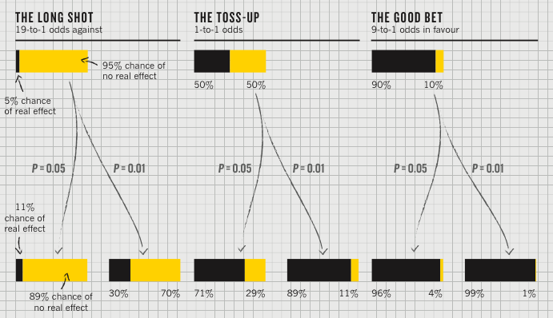
Actual implications of the p-value
P value
Best used to determine what is ‘worthy of a second look’ [Nuzzo]
Limited in its applicability
A small p makes the hypothesis more plausible
Notes:
Does not incorporate the inference (the top of this chart) directly

Slide 46
Key points for t-test
A one-sample t-test tells us whether the mean of a normally distributed population has a value specified in a null hypothesis.
A two sample t-test tells us whether the means of two normally distributed populations are equal
An ANOVA lets us compare multiple factors correctly
Always look at actual difference (size of effect)
Notes:
----- Meeting Notes (4/23/15 09:54) -----
compare multiple FACTORS not GROUPS in an ANOVA

Slide 47
Careful about Correlation
We calculate three things for correlation: The slope & intercept of the line; The amount of error (r); and the significance
Outliers & Non-normal & uneven variance values can make this fail
Subgroups (Simpson’s paradox)
Plan subgroup comparisons ahead
Understand when and when not to do subgroup comparison [Story behind the data!]
Correlation != Causation (what does?)

Slide 48
Regression
Regression tells us to what extent a group of independent variables predict or explain a dependent variable
It is based on the same assumptions as correlation
In addition, predictor variables that are not independent can mess it up
Over fitting can be a problem (too little data for the number of independent variables)

Slide 49
What is machine learning?
Automatically or semi-automatically
Inducing concepts (i.e., rules) from data
Finding patterns in data
Explaining data
Making predictions
Supervised ML depends on labels and features
Labels typically expensive to acquire
Features key to success
Notes:
Too many features can lead to overfitting [but feature selection can help with this]
Too few features can fail to capture the information needed for prediction

Slide 50
Learned Classifiers
Training Time
Method to get Ground Truth
Training Data Set
Feature Gen
f₁ | f₂ | f₃ | … | Label
A | 42 | 17 | … | Yes
C | 78 | 25 |  | No
X | 32 | 4 |  | Yes
Learner
Sensors
Classifier

Slide 51
Learned Classifiers
Run/Classify Time
Feature Gen
Sensors
Classifier
Class

Slide 52
Metrics for assessing results
Accuracy [limited value]
Precision = TP / (TP + FP) = 90/(90+15) = 88%
Recall = TP / (TP + FN) = 90/(90+12) = 86%
F-Score = 2 * (Precision * Recall) = 87%
(Precision + Recall)
Kappa = (observed acc.- expected acc.) (1 - expected acc.)
Notes:
Kappa accounts for skew

Slide 53
Best Practices
Divide your data
Optimization set (for tuning parameters; etc.)
Training set (for training your classifier)
Testing set (for calculating scores)
Estimate performance on training set (10 fold cross)
Test set is for reporting
All data is for producing a classifier to use in the real world
Read your data. Explore it. Try things out (feature sets, algthm parameters). But do it all on the optimization set.
Notes:
Called ‘holdout validation’ : need a large enough holdout set so you can trust the result (and this reduces your training data which you almost never have enough of)

Slide 54
Examples
Decision Trees
Add nodes based on information gain
Contain statements about how features relate to outcomes
Naïve Bayes
Elegant balance of features and prior probabilities
Assumptions: Independence; Closed world
[Most of the time in real data sets the values of the different attributes are not independent of each other]

Slide 55
Comparing them
Decision trees [Open World]
Use contingencies between patterns of attribute values as a basis for decision making
Prone to overfitting [need pruning]
Easy to learn, interpret, use
Naïve Bayes [Closed World]
Robust even when features are missing during recognition (because of prior probabilities) but not during training
Fail when data is highly conditional or skewed

Slide 56
Closed [NB] vs Open World [Decision]
Closed:
Presumes all true statements are known
Observer can thus make inferences about new things: if they are not known, they are false
Open:
No single observer has complete information
Observer can only make inferences about things that derive from things it already know to be true
represent information as we discover it and cannot guarantee that we know everything true
statements depending on unknown features are unknown rather than false
Notes:
Closed:
Presumes all true statements are known
Observer can thus make inferences about new things: if they are not known, they are false
Open:
No single observer has complete information
Observer can only make inferences about things that derive from things it already know to be true
represent information as we discover it and cannot guarantee that we know everything true
statements depending on unknown features are unknown rather than false

Slide 57
Least Squares Regression
Given training examples:
x_{1..i} in R^{n} [our feature vectors]
And labels
y_{1..i} in R
We learn
f(x) = w^{T}x + b
Notes:
Note we can replace y-cap with b0 – b1x

Slide 58
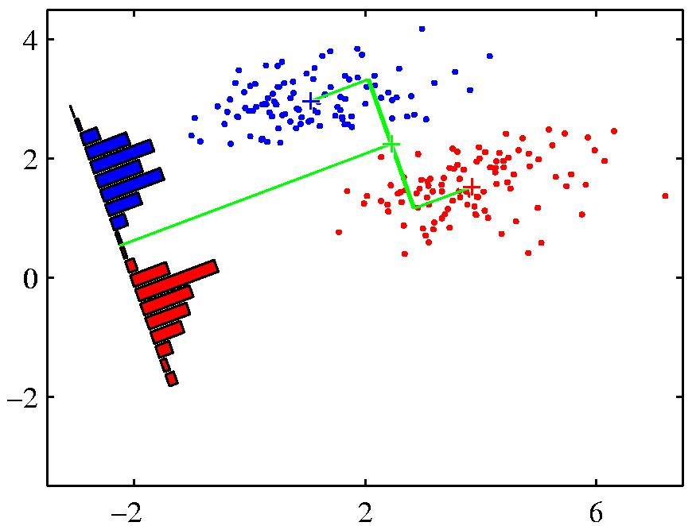
Goal of Logistic Regression
Key idea: instead of predicting a number in R, predict the probability of a class label.
p+ = P(class is positive|features) p- = P(class is negative|features)
Base p on the projection that gives the best separation of the classes.

Slide 59
Regression: Implementing Gradient Descent
Loops over the entire data set S {
At each step change w based on the error and the step size η (the learning rate)
w_{j} = w_{i} - η Δ(w)
simultaneously update all the weights for training instance X_{j}, y_{j}
where p_{w}(x^{(i)}) =
}

Slide 60
How do we handle big data
Batch mode : Gradient Descent
w_{j} = w_{i} - η Δ(w) over the entire data S
Incremental mode: stochastic gradient descent
w_{j} = w_{i} - η * approximation of Δ(w) based on t_{x}-o_{d}
can approximate Batch Gradient Descent arbitrarily closely if η is small enough
supports online learning
easily parallelized
Not guarranteed to reach global minimum

Slide 61

Importance of Intelligibility
Crucial to user’s understanding
What to show users is a critical question that is only partly solve
Different circumstances -> different explanation needs *
How to show is also hard
Several toolkits built by Dey et al to address this
Notes:
Did she fracture any bones in the fall?
How long ago did this happen? How does the system detect falls?
Why did it not tell me about the Museum? How does it determine my loca0on?

Slide 62
Example case studies we talked about
Mouse data (different types of users)

Slide 63
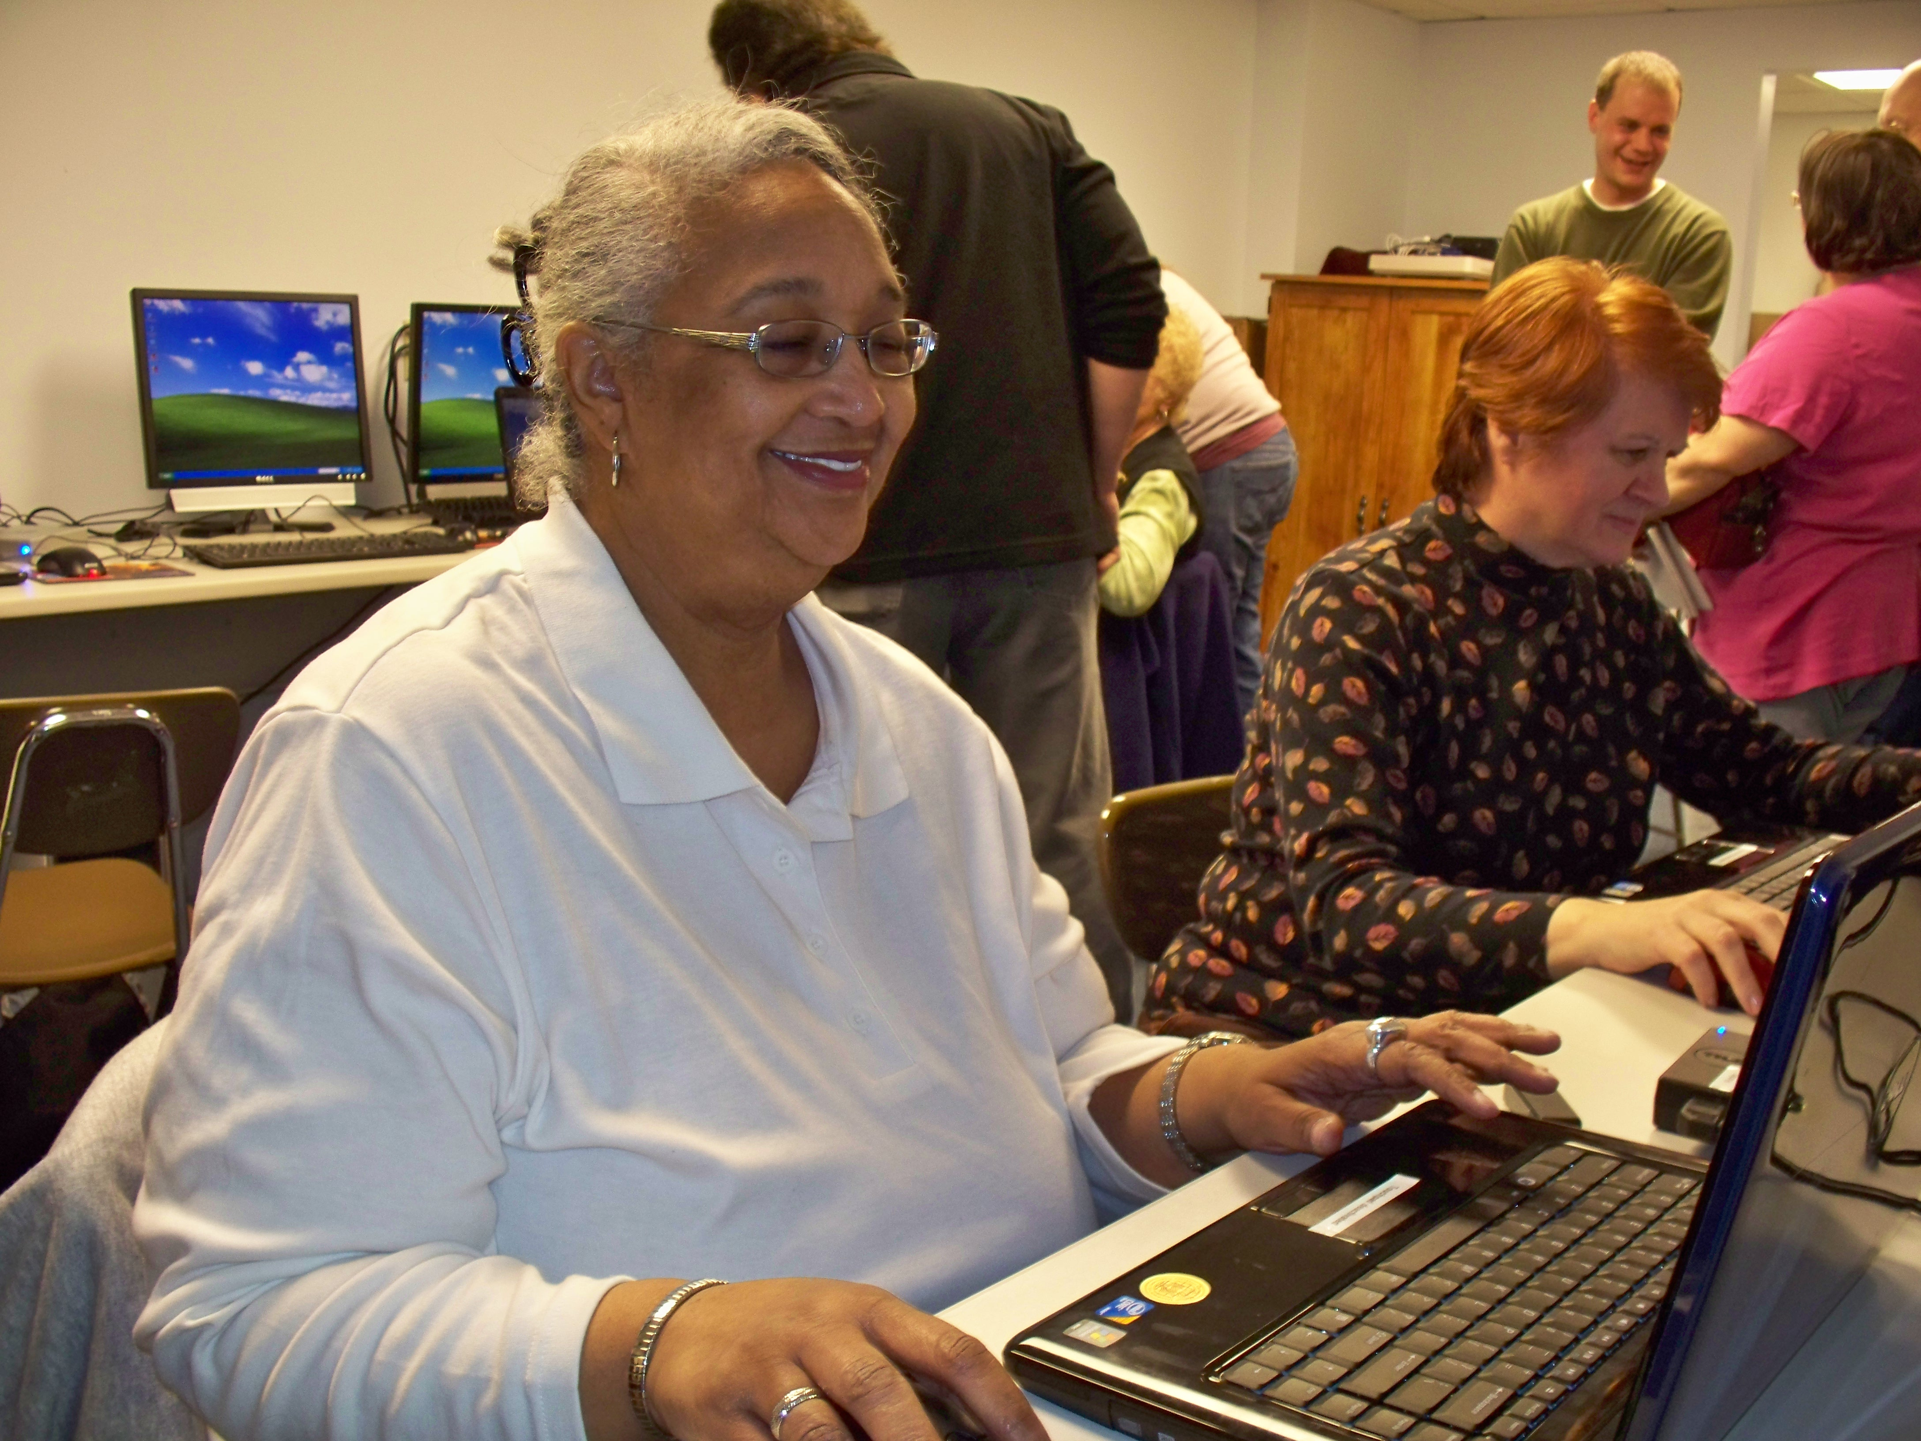
Laptop Deployment: Multiple Groups (July 09 – 10) 17 participants
 | Participants | Female | Average Age | % data collected
Able | 4 | 1 | 29.25 | 22.87%
Older Adult | 8 | 8 | 67.63 | 69.15%
Motor Impaired | 4 | 2 | 41.75 | 7.99%
Notes:
Difficult to segment data

Slide 64
What we learned
✘
✘
Questions
Data Sets
New Questions
✔
Can we characterize pointing problems?
Year of real world data from people with & without pointing problems (and elders)
Can we predict task switches?
Can we predict click targets?
Can we detect pointing problems?
Can we improve targeting?
?
Can we predict what technology will help?
Lab data for people with and without AT
Can we detect routines?
?
Notes:
Are you

Slide 65
What we learned
Questions
Data Sets
Better Questions
✔
Can we characterize pointing problems?
Year of real world data from people with & without pointing problems (and elders)
Visualize how use changes for novice elders over the course of a year
✔
Can we detect pointing problems?
Characterize the aspects of popular applications that are used most/least
✔
?
Can we predict what technology will help?
Lab data for people with and without AT
Predict anything? Hard without labels
?
Notes:
Are you

Slide 66
Example case studies we talked about
Mouse data (different types of users)
Location data [Gates building; Randy Sargent lecture; Byte 4]

Slide 67
Location Data Sets
 | Augsburg Occupancy | CMU Occupancy | UCSD Movement | CMU Movement
Collection Method | Smart Door Plate | BACNet Sensor Queries | PDA-based WiFi triangulation | Phone-based WiFi Triangulation
Frequency | Every Room Change | Every 10 minutes | Every 20 sec | Every 30 sec, while movement is detected
Flaws | Summer and Fall data sets 4 month apart
Room vs. Floor vs. Campus | Covers 1 floor in an office building | Covers every floor in one university office building | Covers several campus buildings | Covers every floor in one university office building
Type | Transitional | Occupancy | Tracking | Tracking

Slide 68
Location Data Sets
 | Augsburg Occupancy | CMU Occupancy | UCSD Movement | CMU Movement
Scope | 4 People, (summer + [break] + fall) | 300 data points per day per room (temp & occupancy) | 275 students, M=11 weeks | 6 People
Total locations | 15 | 293 Rooms | 200 | 2074 (10x10 meter segments)
Days | M=23.25 (SD 3.42) | M=188.65 (SD 4.3) | M=25.56 (SD 20.81) | M=58.1 (SD 32.57)
Data points per person/day | M=316.60 (SD 8.55) | N/A | M=508.46 (SD 739.1) | M=497.65 (SD 273.96)
Locations per person/day | M=6.70 (SD 0.70) | N/A | M=3.45 (SD 2.68) | M=44.97 (SD 10.67)

Slide 69
UCSD Data Set Skew

Slide 70
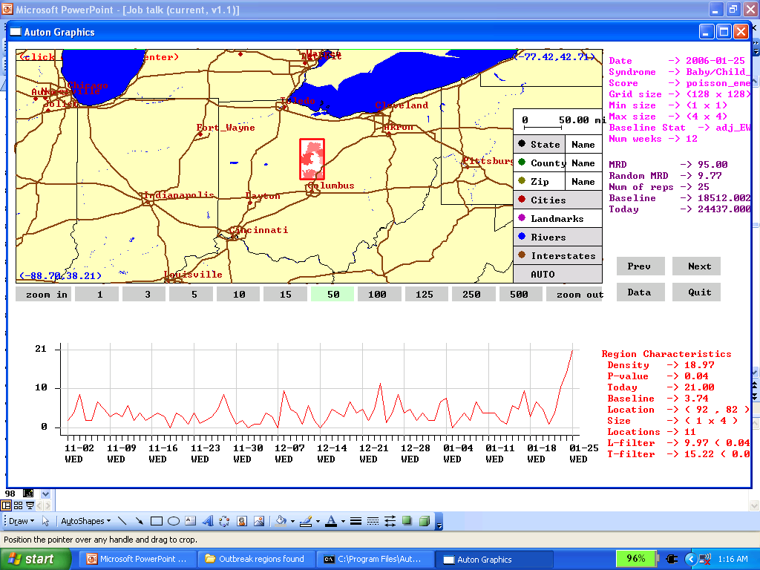
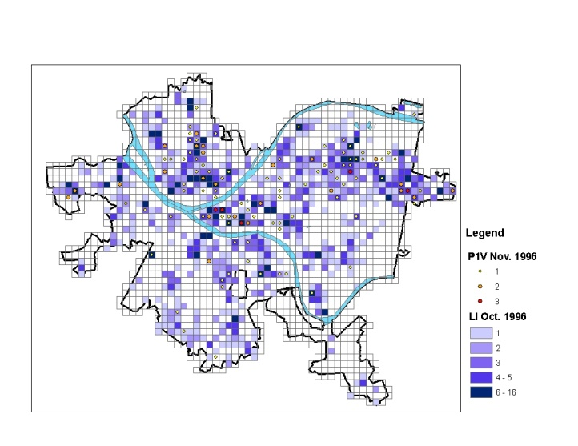
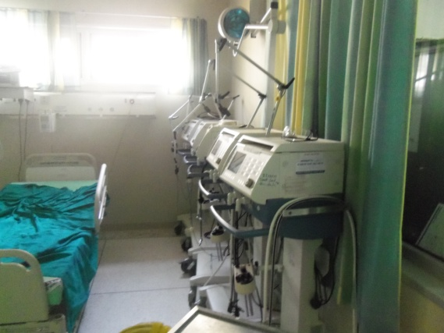
Also Daniel Neill’s lecture
Looked at very large data
Goal: Early detection/prediction of problems
Fast subset scans used to do this [need for new statistical machine learning methods]
Disease Surveillance: Very early and accurate detection of emerging outbreaks.
Law Enforcement: Detection, prediction, and prevention of “hot-spots” of violent crime.
Medicine: Discovering new “best practices” of patient care, to improve outcomes and reduce costs.

Slide 71
What we learned
Many ways to phrase the ‘prediction’ problem
Major problems with quality in published data sets
Location data can get very large very quickly, especially when we include context

Slide 72
Example case studies we talked about
Mouse data (different types of users)
Location data [Gates building; Randy Sargent lecture; Byte 4]
Stepgreen Visualization

Slide 73
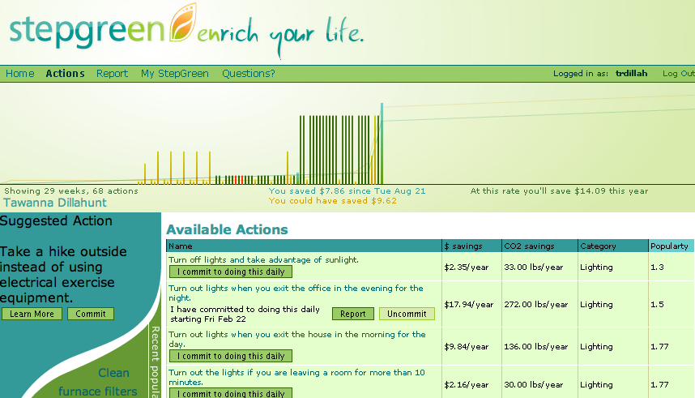
-
Notes:
73

Slide 74
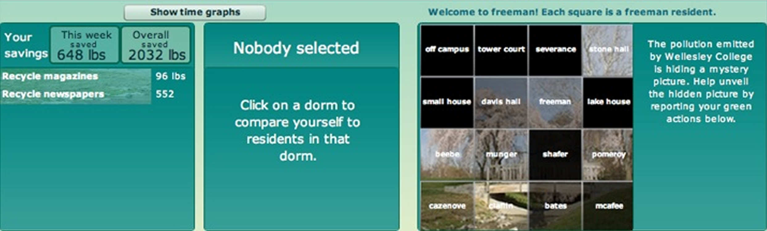
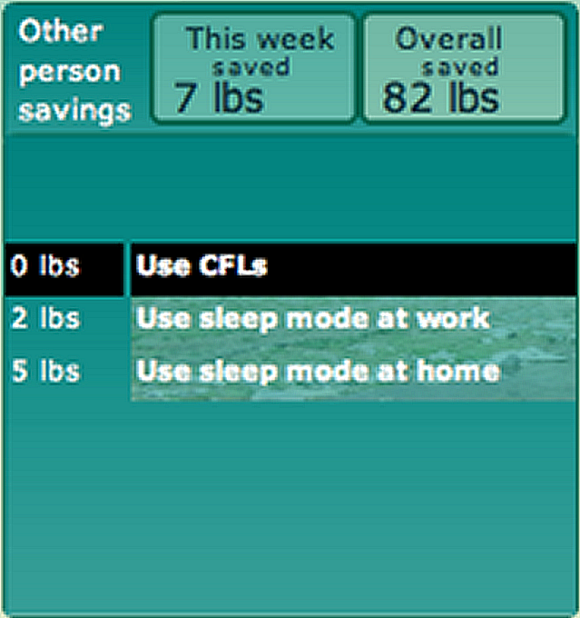
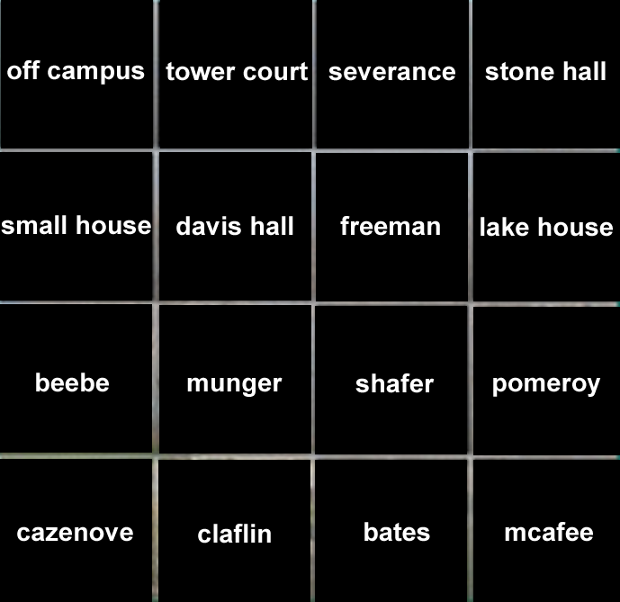
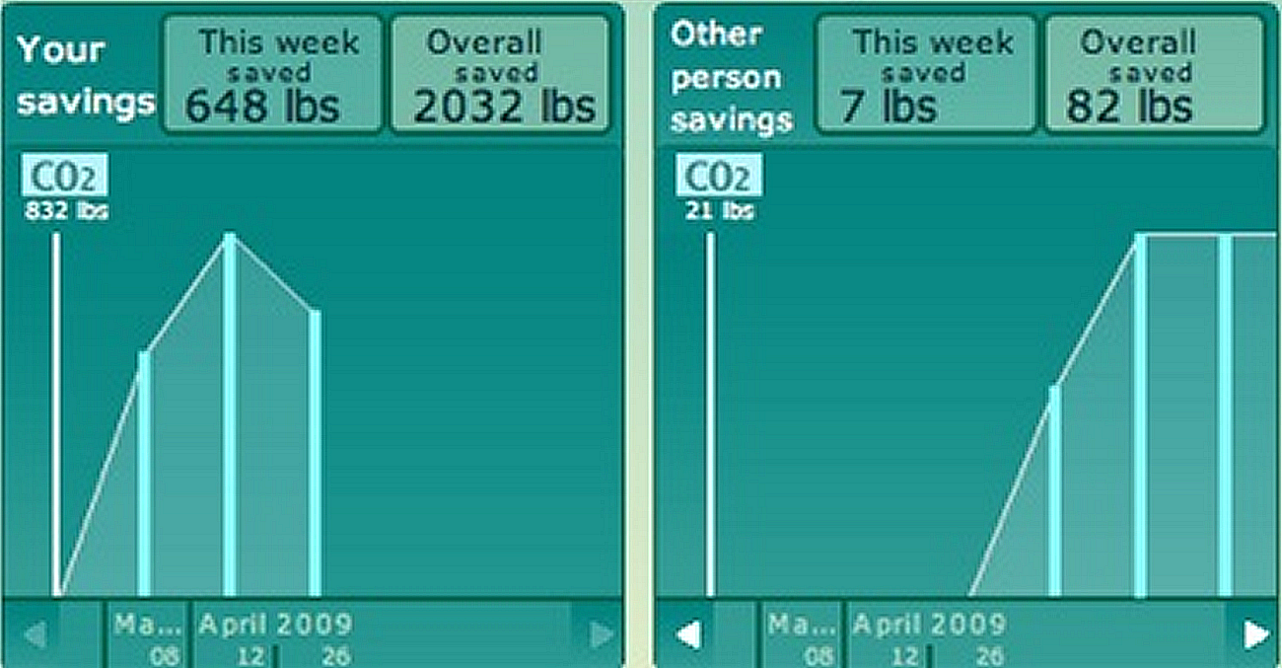
Personal time graph and action breakdown
Display of entire community for overview
Different comparison levels
Opacity for conveying performance
Anonymous

Slide 75
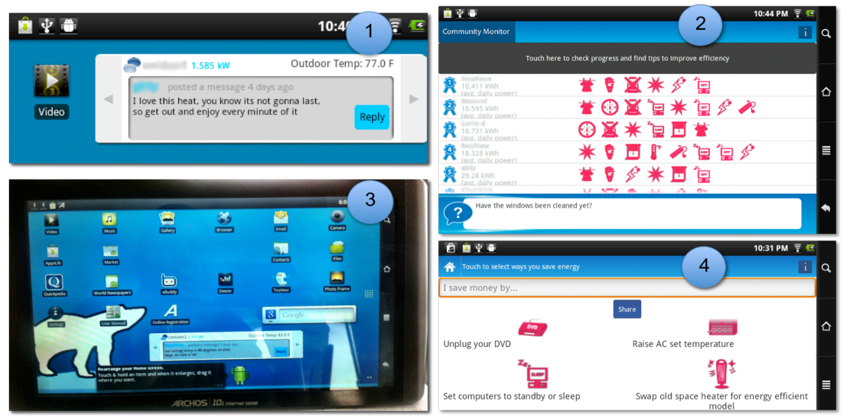
(1) Real time energy consumption. (2) Rankings & commitments & messaging (3) Tablet with wallpaper showing feedback (4) ‘ways to save’ page

Slide 76
What we learned from Stepgreen
Raised questions of context (social vs not; community structure)
Difficulty of separating viz & goals from application & goals
Difficulty of getting clear field vs lab results

Slide 77
Example case studies we talked about
Mouse data (different types of users)
Location data [Gates building; Randy Sargent lecture; Byte 4]
Stepgreen Visualization
Mobile data [Byte 4]

Slide 78
Mobile: Big Data of 1
Accelerometer
Applications
Battery
Bluetooth
Calls
Messaging
Gravity
Gyroscope
Light
Linear Accelerometer
Location
Magnetometer
Network Usage
Orientation
Pressure
Processor
Proximity
Rotation
Screen
Telephony
Temperature
Traffic
Wi-Fi
… many more

Slide 79
Three false assumptions of mobile
Phones are smart [not so much about context]
Apps are used [usually not; usage is also diverse with 95% of sessions < 60secs]
Notifications lead to use [only 25% of use!]
Phones are on & on people
1/5 of the time phones are off
50% in reach; 47% further away
Adapted from http://www.fordham.edu/economics/Vinod/correl-regr.ppt

Slide 80
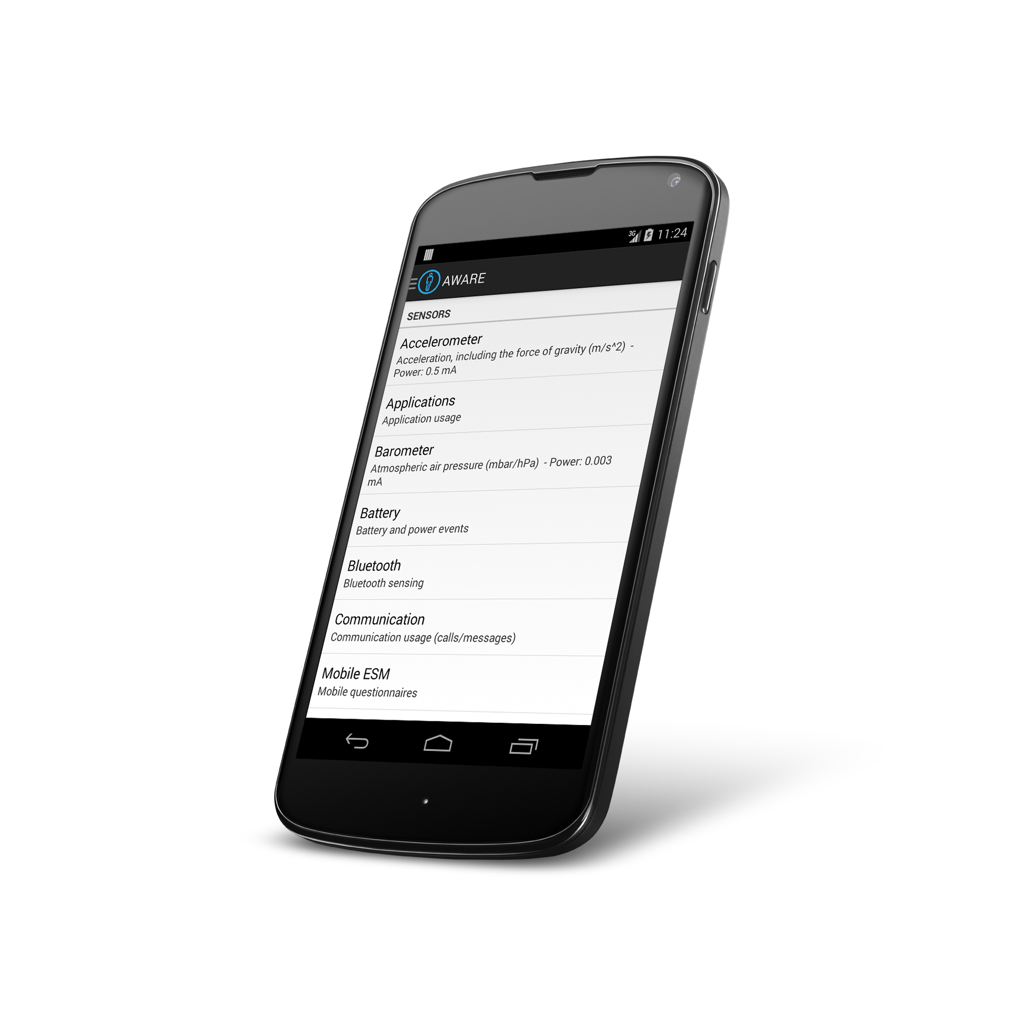
Aware Framework Dey & Ferreira & Kostakos (Oulu)
awareframework.com Collaborative mobile sensing for understanding human behavior and social wellbeing
Developer
Scientist
User

Slide 81
Dr. Doryab gave many examples
Mental Illness
[Bipolar] Explored features that are lower cost (don’t require reporting). Showed they could still be helpful
[Depression] Explored behavior change. Found gender based patterns in social communication.
Sleep [Toss’n’Turn app]
Impact of multiple people in bed
General vs. individual models [better]

Slide 82
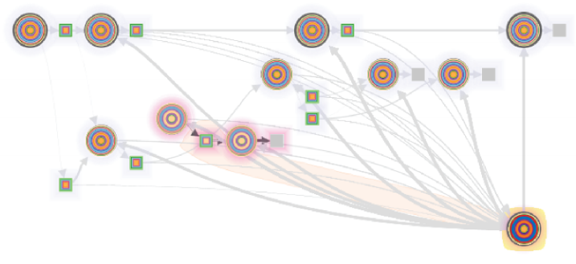
Nikola Banovic discussed routine extraction and visualization
A learned sequence of actions people perform in a given context that help them achieve a desired goal
driving routine showing the combination of extracted routine, researcher defined routines, researcher custom defined clusters
Notes:
a sequence of actions people perform that help them achieve a desired goal

Slide 83
What we learned
Phones are not as omniscient as we might think
Sensor data is collected in uncontrolled conditions thus bound to noise and deficiency
Changing technology a cause of inconsistency in the data
Often lack ground truth

Slide 84
Example case studies we talked about
Mouse data (different types of users)
Location data [Gates building; Randy Sargent lecture; Byte 4]
Stepgreen Visualization
Mobile data [Byte 4]
Big Text

Slide 85
Bad Data Handbook
Chose a key-value store + map reduce
Poor debugging experience
Fast write / slow read was a bad match

Slide 86
Example case studies we talked about
Mouse data (different types of users)
Location data [Gates building; Randy Sargent lecture; Byte 4]
Stepgreen Visualization
Mobile data [Byte 4]
Big Text
Networks

Slide 87
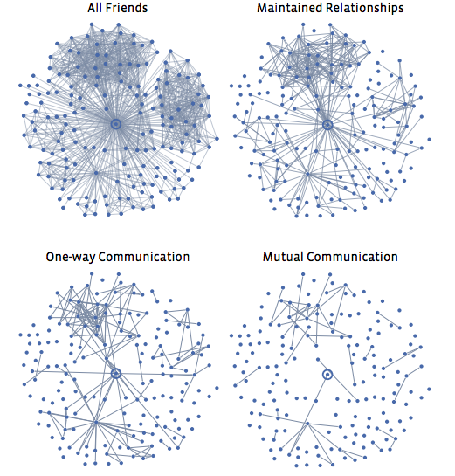
Dealing with Network Data
Networks show up all the time in data
Structure of network matters
Behavior & Influence
Key metrics explore structure, influence, and network evolution (over time)
Notes:
Structure:
Important to know about groups within a network. How big? Are there many or just one? Which people are central to those groups?
Gaps in connectivity may need fixing
Weak ties can act as ‘shortcuts’
-> 6 degrees of separation
Balance can be used to reason about fissures and how local issues (such as antagonism) can affect structure
Strong & weak ties
Behavior & Influence: Game theory: behavior conveys information -> information cascades
Behavior conveys value -> network effects [e.g. rich get richer]

Slide 88
Types of networks
Collaboration graphs
Who-talks-to-Whom graphs
Information Linkage graphs
Physical networks
Natural World networks include food webs (who eats whom) or the brain’s neural connections

Slide 89
Example case studies we talked about
Mouse data (different types of users)
Location data [Gates building; Randy Sargent lecture; Byte 4]
Stepgreen Visualization
Mobile data [Byte 4]
Big Text
Networks
Tiramisu

Slide 90
Tiramisu
Crowdsource realtime trip data
Crowdedness
Cleanliness/driver/etc
Wanted to communicate with providers [union issues]
Really highlights how deployed data science is heavily influenced by people issues!
‘forced’ contribution -> Unexpected negative impact on retention
Battery: Working on technical advances
Impact on people w/ disabilities??

